Slide 1
BasketBuddy
ITIS 3300 Project Presentation

Slide 2
Team Members - The Core 4
Team Members | Responsibilities
Tyler Niemonen | Team captain, helped with formatting deliverables while ensuring deadlines were met. Organized weekly team meetings (Sundays). Helped with the overall design and front end development of our project. Helped with JS & Bootstrap functionality of our webpage. Helped create some unit testing.
Carson Carmody | Created the initial HTML pages for the application. Developed the JavaScript for the lists functionality. Made diagrams and formatted deliverables.
Jakia Gary | Helped edit the powerpoint, assisted in understanding the group feedback, helped design the website and testing of the web app
Ryan Wegener | Managed the project’s GitHub repository and maintained the GitHub Pages version of the site. Contributed to the JavaScript development class-based system used throughout the project and implemented catalog search and filtering and user account features. Helped test and refine page layouts and navigation.
Jeff Pautrat | Helped create the demo video and go through the powerpoint to make sure stuff was done, helped create specific JS and core functionalites, helped through with design and testing.

Slide 3
Project Overview
Purpose:
To create a web-based grocery shopping application, called BasketBuddy. Shopping for groceries can often be time consuming and convenient, but BasketBuddy does all of the shopping for you.
Goal:
To develop a simple, yet reliable medium for users to shop for groceries online, putting time back in the hands of the shopper.

Slide 4
Core Functional Requirements
The system must allow users to create an account by entering their name, email, and billing information.
The system must display a product catalog showing grocery items with names, prices, and images.
The system must allow users to add, remove, and update quantities of products in their shopping cart.
The system must calculate subtotal, total price, and discounts if applied in the shopping cart automatically.
The system must allow users to enter coupon codes and apply the corresponding discount to the order total.
The system must award users reward points at the rate of one point per $10 spent on groceries.
The system must update and display the reward points tracker on the home page after each successful checkout when logged in.
Users must be able to sort and filter items while looking through the catalog of goods.
Users must be able to create, manage, or delete lists.
Users must be able to see past orders after they checkout.
Users must be able to edit their profile and delete their account.

Slide 5
Core Non-Functional Requirements
All pages must load within two seconds on a standard internet connection.
When the catalog is loaded, sorting and filtering must be completed in under two seconds after the user requests it.
When a user interacts with any button or menu, responses must occur within one second of the request.
When the cart page loads, updating quantities or removing an item must refresh the total within one second without reloading the page

Slide 6
Implementation
The app is a web-based grocery shopping platform that simulates real-time cart management.
Built using HTML (w/ Bootstrap) and JavaScript to store information via local storage.
Core components include the home, account, product, catalog, cart, checkout, lists, and rewards page.
Designed with a focus on convenient navigation and overall responsiveness.
GitHub managed the version control and details our collaboration.

Slide 7
Peer Review Feedback
The feedback received was overall highly positive. The feedback complimented the layout and functionality itself. However, two key security concerns were mentioned. First, the reliance on local storage for authentication can easily be spoofed. Also, the listing of the coupons array in JavaScript makes it simple for a user to modify it with inspect tools. Overall, we were recommended to move over to a client-server system to take advantage of the server-side authentication, which has hashing algorithms like Argon2.
While these suggestions are critical for security, our group was forced to defer this implementation. For now, we have decided to continue with the current architecture to prioritize simplicity and to maintain our speed of development to ensure that we meet the project timeline.

Slide 8
Testing Experiences
We turned our core requirements into test scenarios (create account, browse catalog, add/remove items, checkout, rewards, lists, and order history).
Most main tasks worked: users could sign up, add items to the cart, apply valid coupons, and see reward points after checkout.
Testing helped us discover bugs, such as:
Cart totals not updating right away after quantity changes
Rewards not refreshing until we updated the DOM
Edge cases with coupon codes and empty fields
Our biggest takeaway from the project was that clicking through all pages and prompts to fully interact with the website was our best way of finding bugs.

Slide 9
Limitations & Constraints
Project Timeline:
The project timeline was the most significant limitation for our development. Implementing a database to support account creation and authentication would require a much greater deadline. Not to mention, making BasketBuddy compatible with local grocery stores and handling payments would take even longer.
Communication & Meetings:
Although we overall communicated well as a group, it often was still difficult to organize all five members to meet. Jobs, responsibilities, and other classes all stood in the way of our availability.

Slide 10
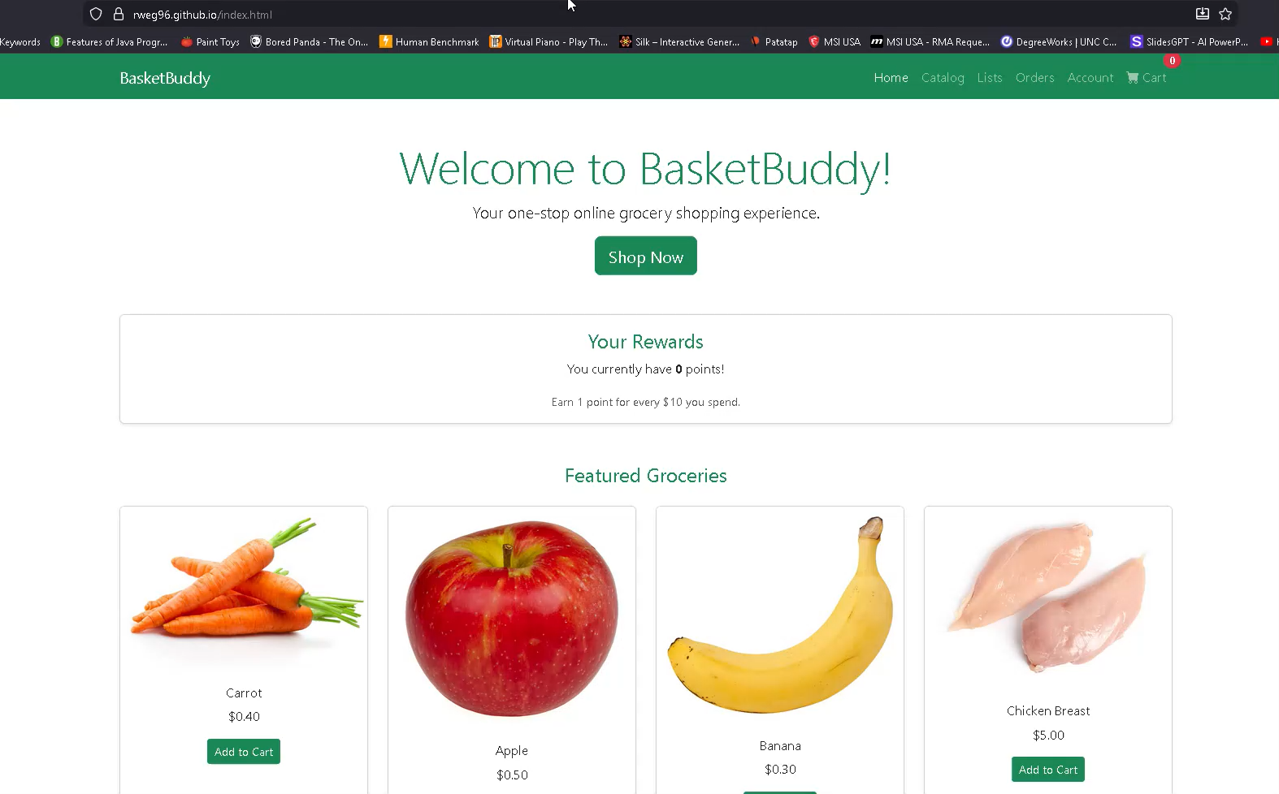
Demo Video
BasketBuddy Website
Google Drive Link to Demo (backup)

Slide 11
Conclusion
We built BasketBuddy, a grocery shopping web app:
Users may:
Create an account
Browse the item catalog
Manage their cart
Apply coupons
Earn rewards
Create & save lists
Manage past orders
Our goal was to develop an application that enabled users to grocery shop faster. Our final prototype meets that goal. This project gave our team the experience of turning written requirements into code, and then an application. Peer review and testing revealed that our layout and flow is strong for a class project. However, an actual backend with proper security would allow proper deployment of it for public use. A greater development time frame would allow us to implement these features and expand upon the application.
Future: Move to a client–server setup, with a real database and proper authentication. Moreover, hardening security, expanding the item catalog to house more items, and improving mobile responsiveness would make the application stronger.

Slide 12
References
In-class lectures from Canvas
Youtube tutorial videos (example)
JUnit Tutorial on W3Schools
Bootstrap Tutorial on W3Schools
JavaScript Tutorial on W3Schools
HTML Tutorial on W3Schools

